Slide 1

Mobile photo editor testing PicsArt
Created by Alena Basanets
Lv-414.TAQC

Slide 2

Agenda
About PicsArt
Smoke testing
Functional testing
Non-functional testing
Performance testing
Compatibility testing
UI testing
Portability testing
Usability testing
Defect 1
Defect 2
Confirmation and Regression

Slide 3

About PicsArt 12.1.3
PicsArt is an image editing, collage and drawing application and a social network.
PicsArt enables users to take and edit pictures, draw with layers, and share their images with the other users.
PicsArt community and on other networks like Facebook and Instagram.
The app is available on iOS, Android, and Windows mobile devices. It is also available on PCs running Windows 8.1 or higher.

Slide 4
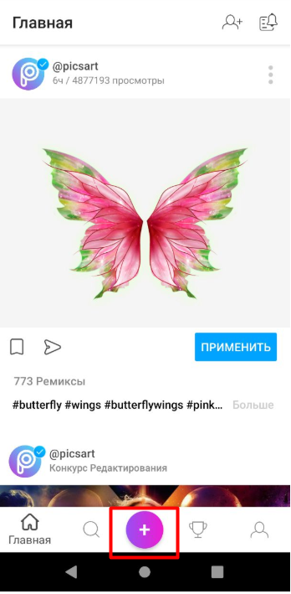
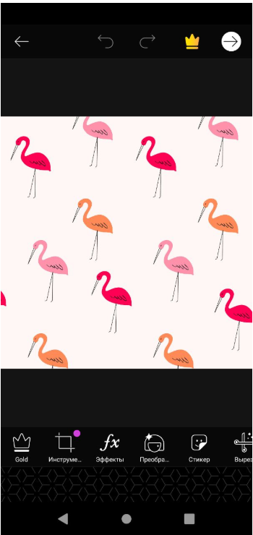
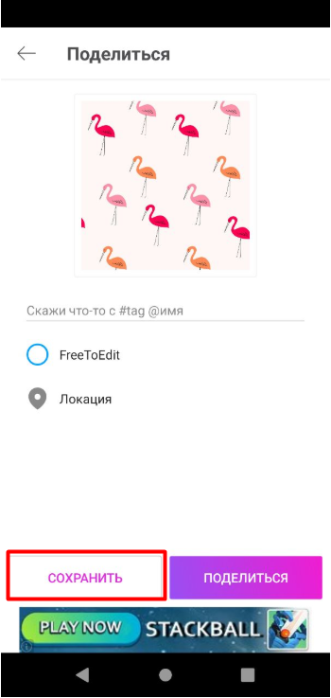

Smoke testing
Requirement: As user I want to upload photos to an application,to edit and to save it.
Actual result : This app has the ability to upload any photo and save it, has some tools for editing.
Upload
photo

Slide 5
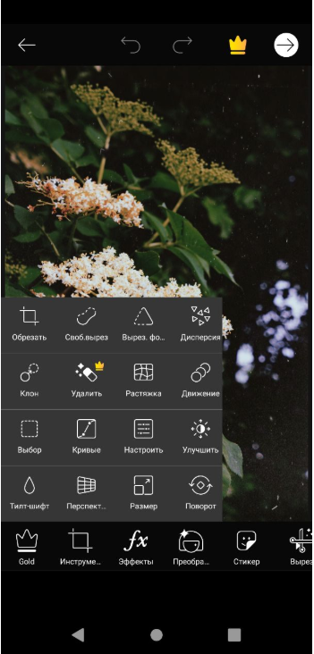
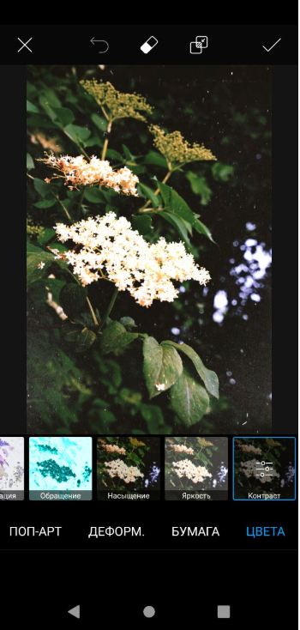
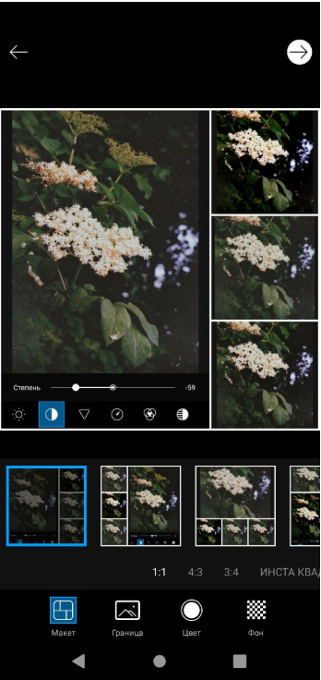
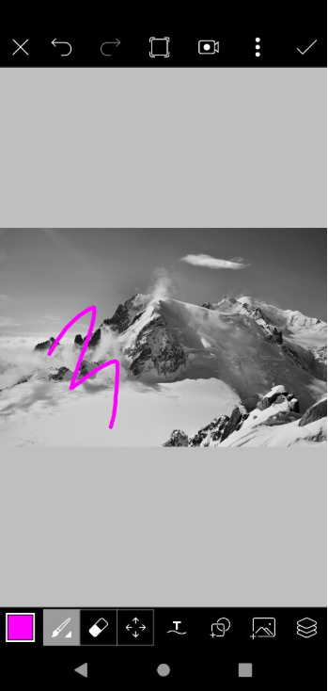
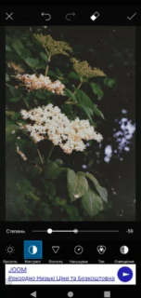
Functional testing
Requirement: As user I want to have the ability to manipulate the photo (upload a photo, edit a photo, create new pictures, draw, create a collage, save a photo).
Example:

Slide 6
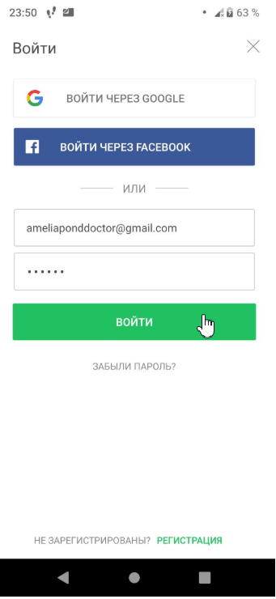
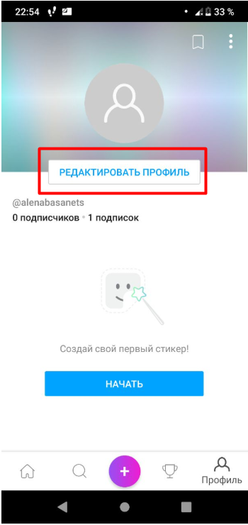
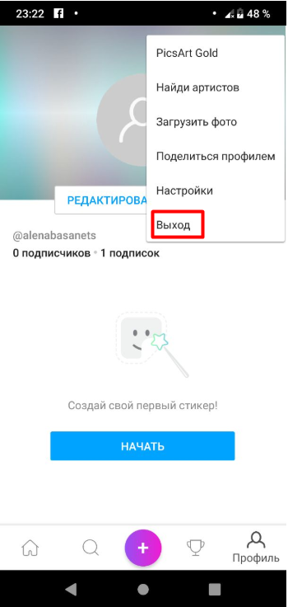
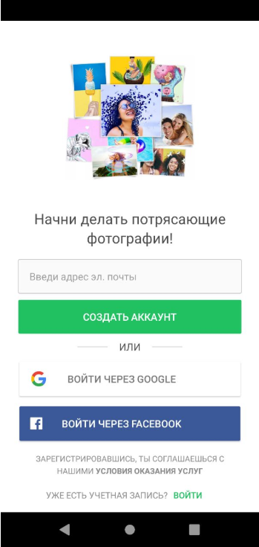
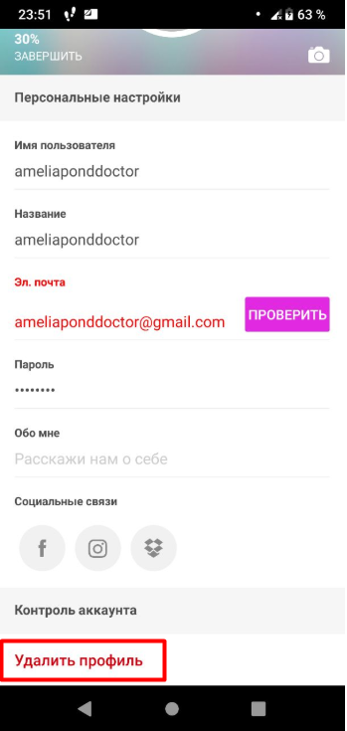

Functional testing
Requirement: As user I want to create profile, to log in, to log out, to edit profile,to delete profile,to change settings.

Slide 7
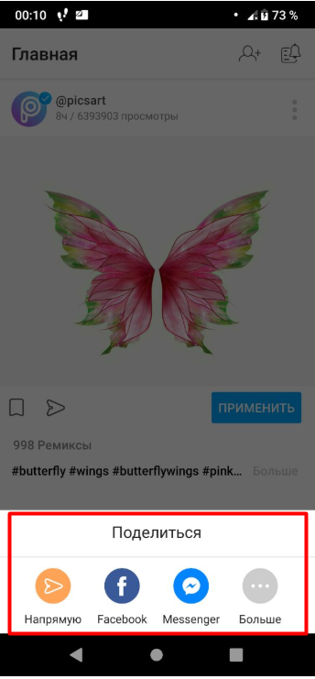
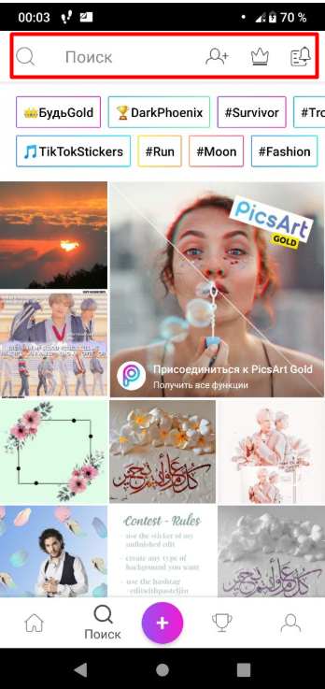
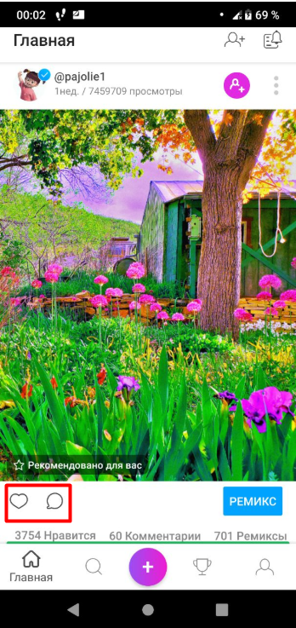
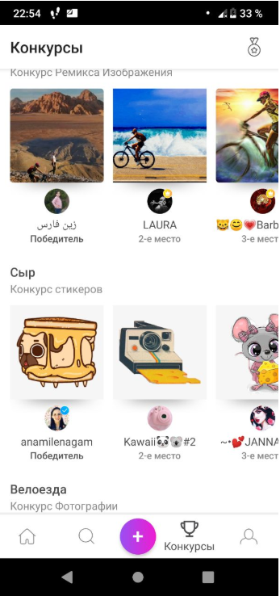
Functional testing
Requirement: cooperation with other users and apps (share photos with other registered users, put a like, write a comment, repost, participate in contests, search, share in social network).

Slide 8
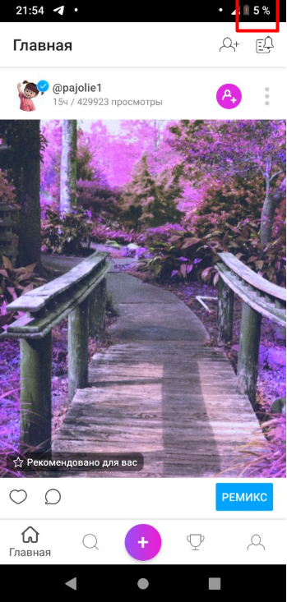
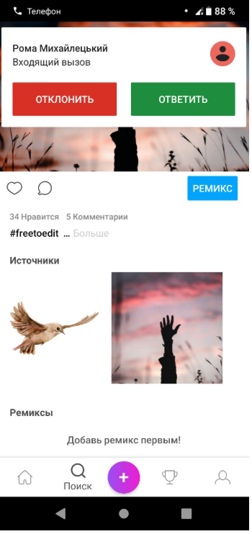
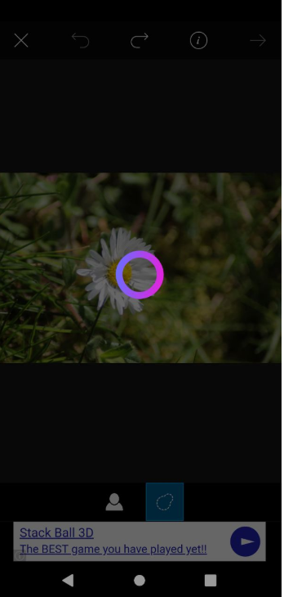
Performance testing
Requirement: The system should be loaded and perform operations for 3 second.
The system is loaded and reacts to any actions 10-14 seconds.
Load testing
The app is loaded and reacts to any actions 10-14 seconds if 1000 users apply it simultaneously.
Stress testing
The app works when the call is in progress, the battery is low, in battery saving mode, resumes work after crash.

Slide 9

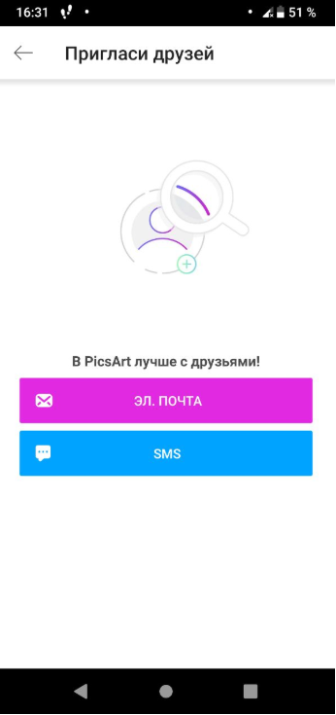
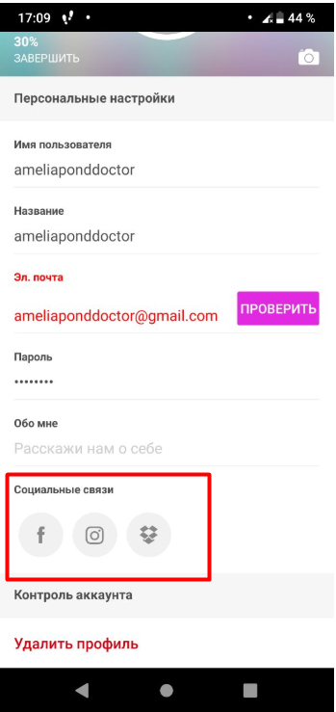
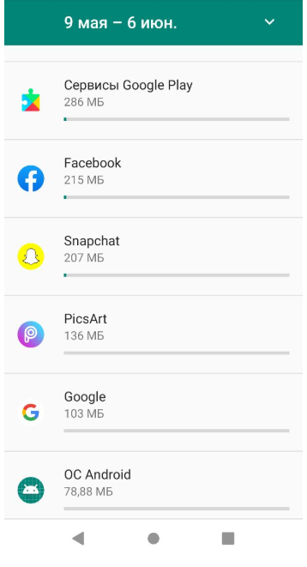
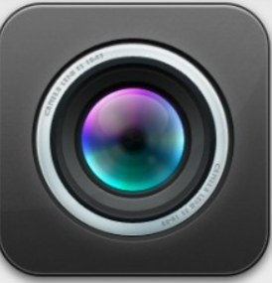

Compatibility testing
Requirement: The application shouldn`t conflict when interacting with other applications. Cooperate with Facebook Instagram
The application can use the camera when the application “Camera” is open. PicsART can use shared data with other apps.

Slide 10
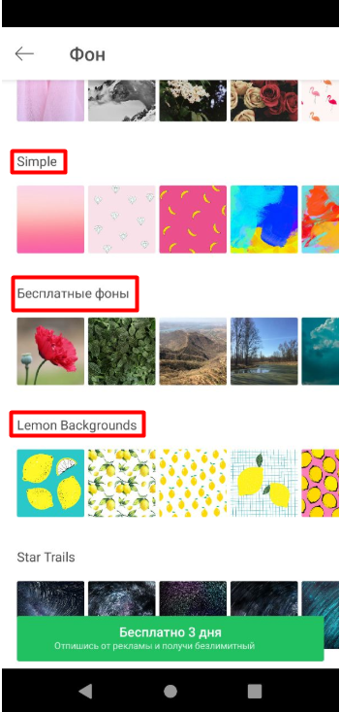
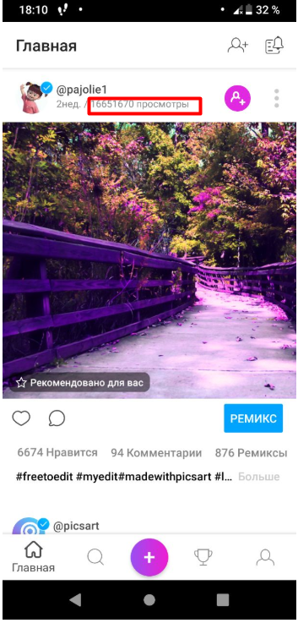
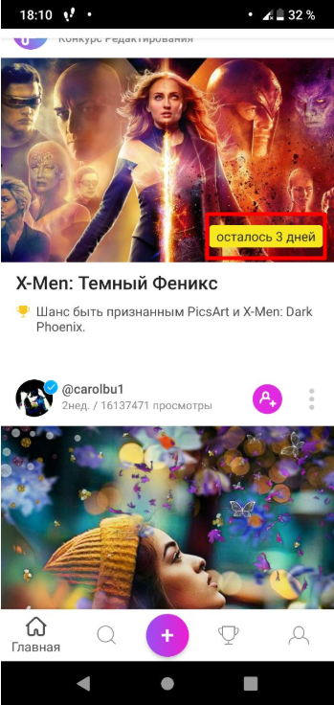
UI(localization) testing
Requirement: The system should provide correct translation from English and German languages to Ukranian.

Slide 11
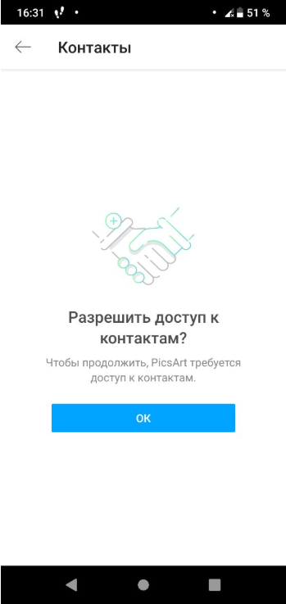
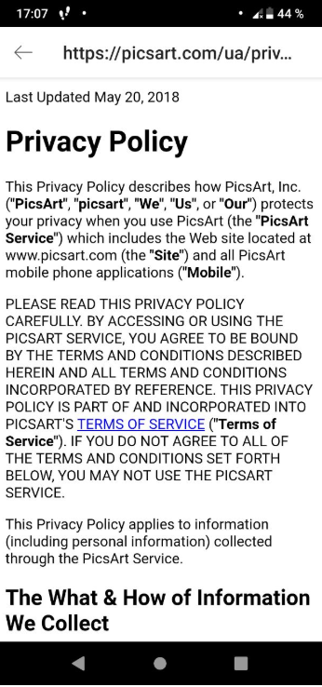
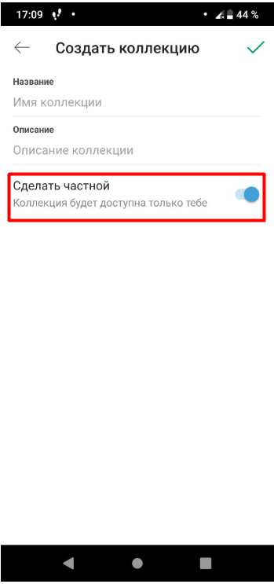
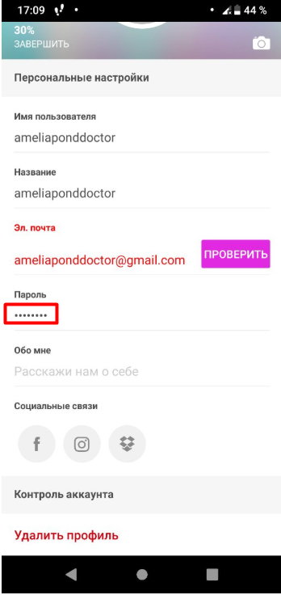
Security testing
Requirement: As user I want have the opportunity save my data from unauthorized access.

Slide 12
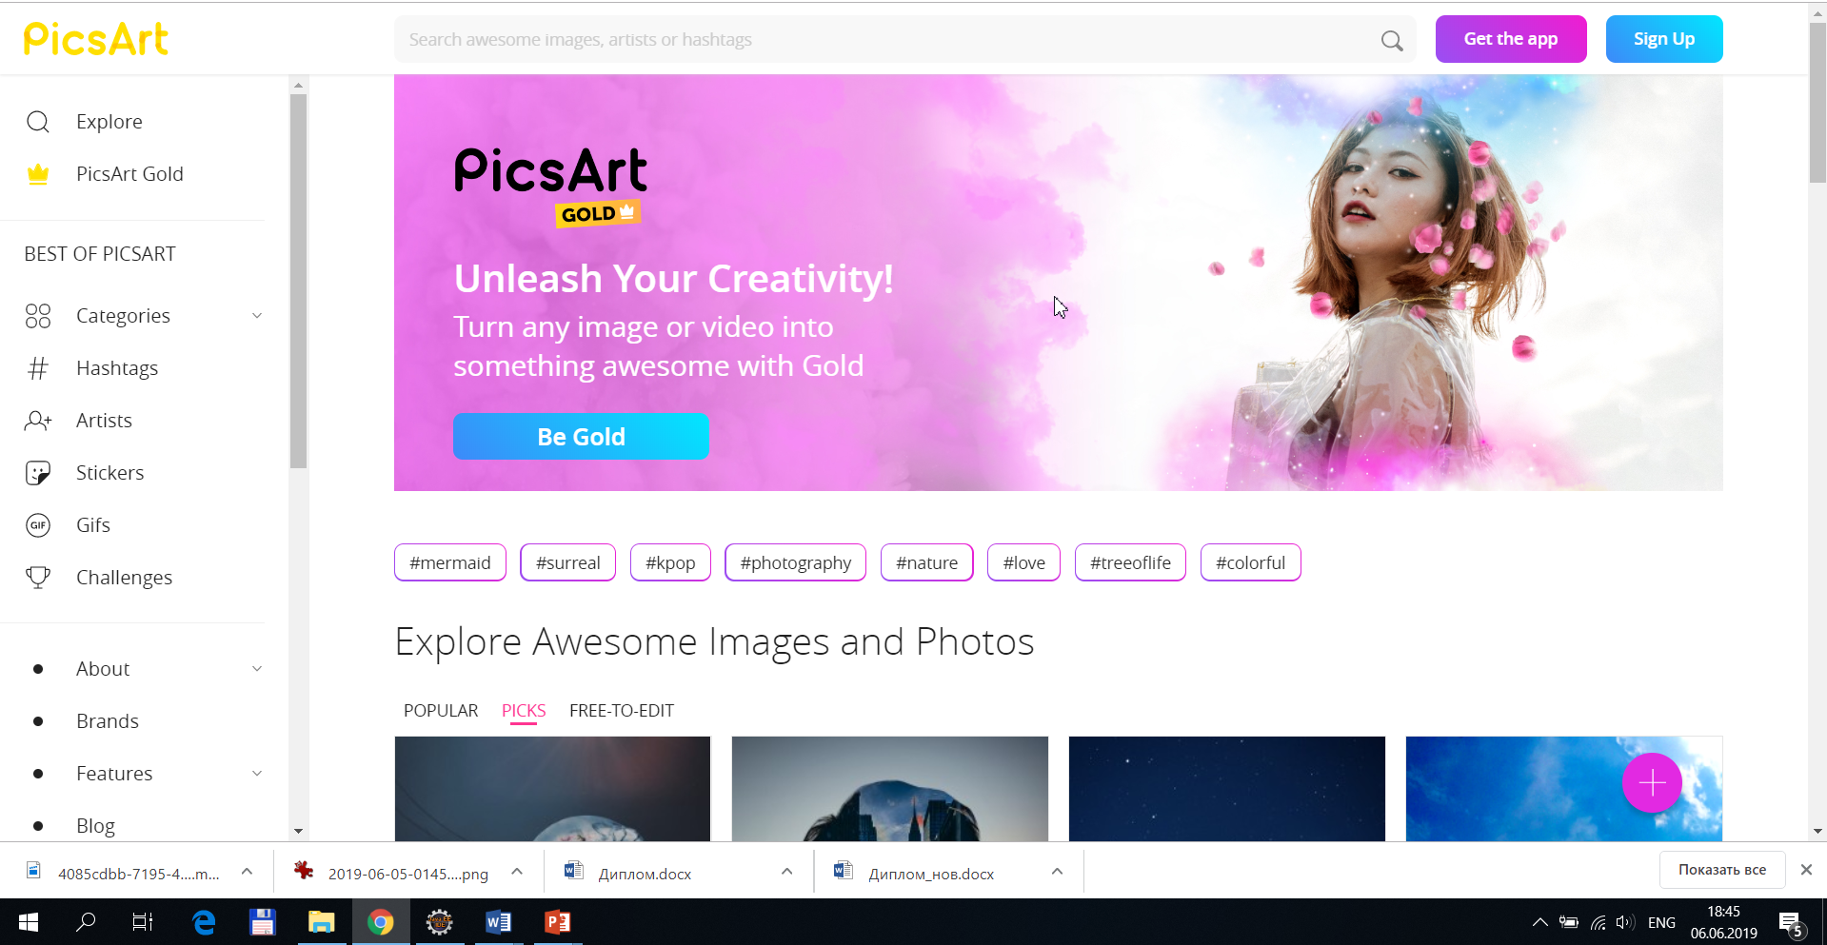
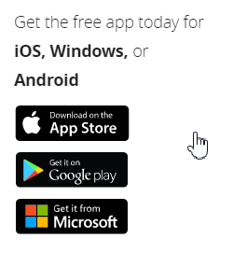
Portability testing
Requirement: The system should be a cross-platform. The system should work in different browsers as Google Chrome, Opera, Mozilla FireFox and Operating systems as Windows, Android and iOS.

Slide 13

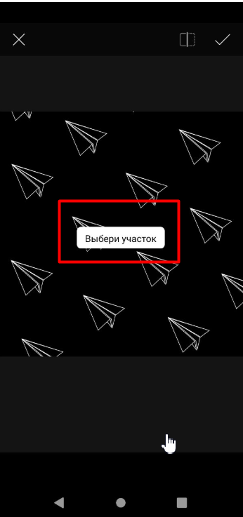
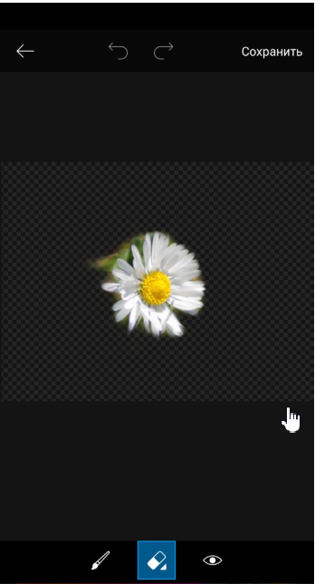
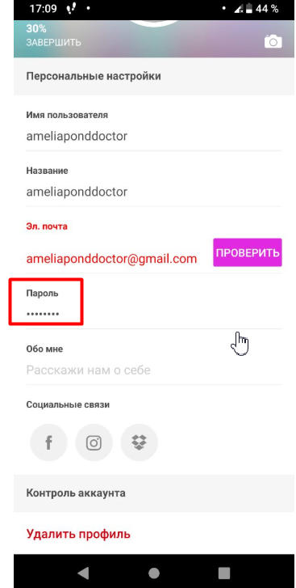
Usability testing
Requirement: As user I want to have hints on possible features.
The app doesn`t allow you: FAIL
to change the language
download images
edit photos in different scales
view your password.

Slide 14
Defect 1
Summary: On “Edit profile” page after click on button “Arrow back” the error window follows.
Steps to reproduce:
Open application “PicsArt”
Log in as user
Click on “Profile”
Click on “Edit profile” button
Change and save the password
Click on button button “Arrow back”
Expected result: Back to “Profile” tab after click on button “Arrow back”.

Slide 15
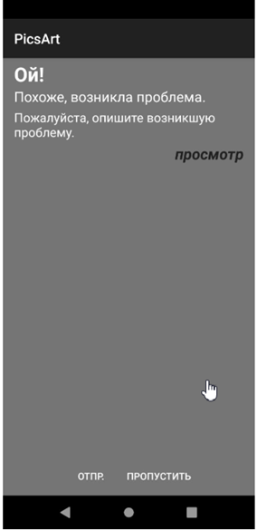
Actual result: the error window follows On “Edit profile” tab after click on button “Arrow back”.
Priority: Medium
Severity: Blocker
Reproducible: Ones
Environment: Android v.9
Defect Type: Functional

Slide 16
Defect 2
Summary: The appropriate page was not opened after clicking the “Search in transaction log” link.
Steps to reproduce:
Open application “PicsArt”
Log in as user
Click on “Profile”
Click on “Settings” page
Click on “Search in transaction log” page
Expected result: “Search in transaction log” page will be open

Slide 17
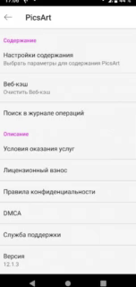
Actual result: There isn`t reaction after click on “Search in transaction log” link. “Search in transaction log” link won`t be open
Priority: High
Severity: Critical
Reproducible: Always
Environment: Android v.9
Defect Type: Functional

Slide 18
Confirmation and Regression
Confirmation:
Defect 1 - PASS
Defect 2 – FAIL Re-open
Regression
Defect: On “Edit profile” tab button “Arrow back” isn`t available.

Slide 19

Thank you for attention

